Slide 1


MIS for Gym: Membership and Equipment Utilization Tracking
-By
A. Kamalisri - 192110429
Keerthana Ps - 192110454

Slide 2
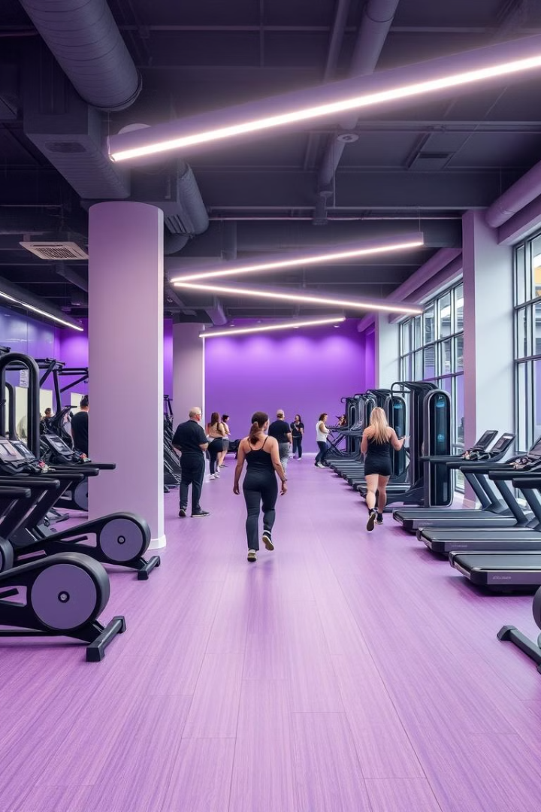
Introduction
A smart gym management system automates member tracking and equipment monitoring. It provides real-time data on gym occupancy. It enhances resource optimization and customer experience. This system utilizes DBMS, IoT, and Business Intelligence (BI).

Slide 3
Problem Statement
Manual Tracking
Lack of Real-Time Data
Limited Analytics
Manual tracking of gym members is inefficient and prone to errors.
There's no real-time data for equipment utilization, hindering effective management.
Lack of analytics on peak hours and workout trends impacts decision-making.

Slide 4

Key Objectives of the Smart System
1
Automate Membership
2
Monitor Equipment
Monitor real-time equipment usage with IoT sensors.
Automate membership management for 1,000+ members.
3
Generate Reports
Generate reports on peak hours and workout trends.

Slide 5
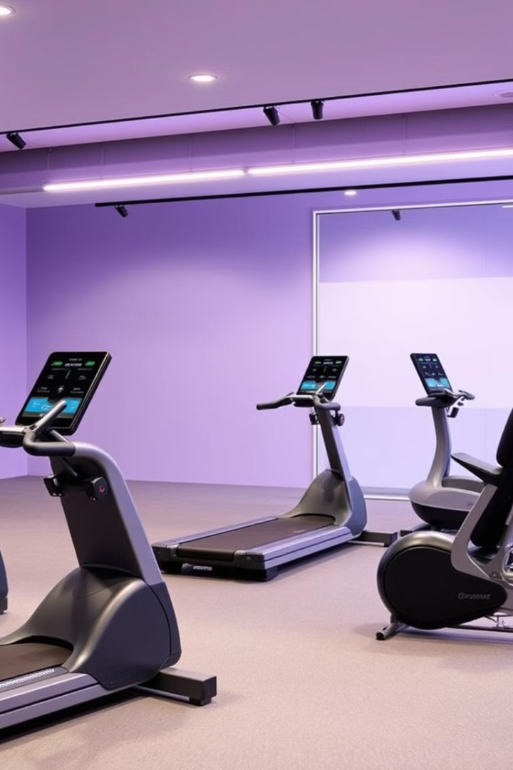



Essential System Requirements
Hardware:
RFID/NFC Check-in
for seamless entry
IoT Sensor
to track equipment usage
Cloud Storage
for secure data storage
Software:
Tech Stack: React.js for frontend, Node.js for backend, MySQL/PostgreSQL for database.
BI Tools: Power BI or Tableau for analytics and visualization.

Slide 6




Core Functional Requirements
Automated Check-in
Automated member check-in & attendance tracking.
Real-time Monitoring
Real-time equipment utilization monitoring.
Workout Analytics
Workout session history & analytics.

Slide 7




Non-Functional Requirements for Reliability
Scalability
Can support 1,000+ members across multiple gyms
1
Performance
Fast and efficient data retrieval for analytics
2
4
Availability
99.9% uptime with cloud hosting
3
Security
Ensures data encryption and secure authentication

Slide 8



User Roles and Responsibilities
1
Admin
2
Trainer
3
Member
Each user role has specific responsibilities. Admins manage memberships and equipment. Trainers track member progress. Members check in, view progress, and renew.

Slide 9
Data Flow and System Outputs
1
Member Registration
2
RFID Check-in
3
Workout Data
User inputs drive the system. Member registration captures vital details. RFID check-in tracks attendance. Workout data provides performance metrics.

Slide 10
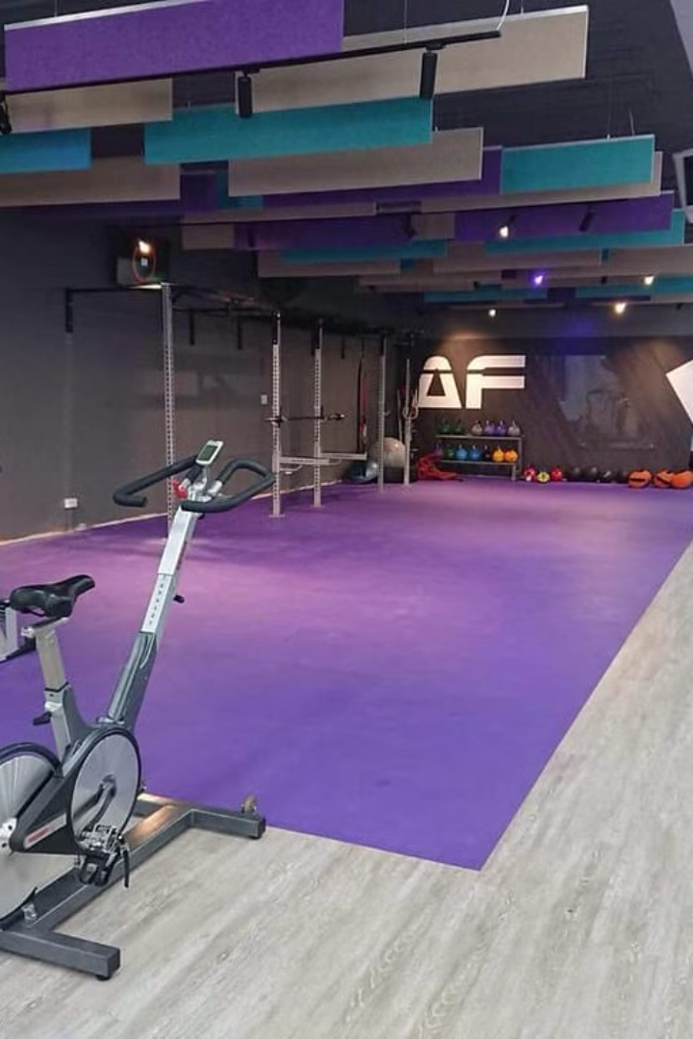
Frontend Development Details
Framework
User Interface
React.js is the Framework.
Tailwind CSS offers a clean look.
State
Redux manages state effectively.

Slide 11
Backend Development Highlights
Framework
Authentication
APIs
Node.js with Express.js handles requests. MySQL stores data.
JWT and OAuth enhance security.
RESTful APIs enable real-time data access.

Slide 12



Database Design & Schema
Users Table
Memberships Table
Equipment Usage Table
Stores user credentials. Contains ID, name, role, email, and password.
Details membership plans. Includes member ID, plan type, start and end dates.
Captures equipment utilization data. Tracks usage ID, equipment ID, member ID, timestamp, and duration.

Slide 13

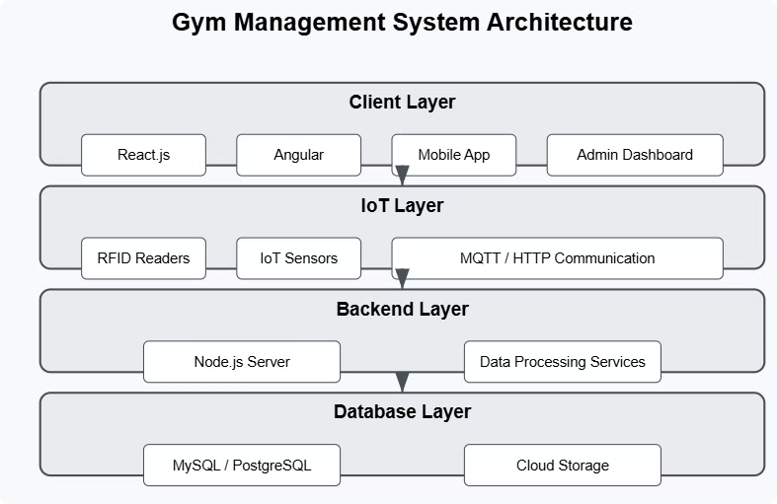
System Architecture
Frontend
React.js
Backend
Node.js
Database
MySQL/PostgreSQL
The system features a React.js frontend. Node.js handles the backend logic. MySQL/PostgreSQL stores the data. IoT sensors and RFID readers integrate via MQTT/HTTP. BI tools generate reports and visualizations.

Slide 14

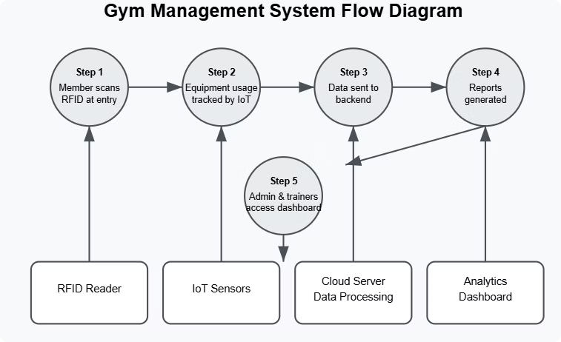
System Flow
1
Data from members going through the gym.
2
Data passed to the cloud.
3
Data is analyzed and viewed by the admins.
Gym members provide data and analytics which is then compiled by cloud-based admins.

Slide 15
IoT & Real-Time Monitoring
RFID/NFC Tags
IoT Sensors
Cloud Data
Automatic member check-ins.
Track equipment usage.
Real-time analytics & alerts.
RFID/NFC tags automate member check-ins. IoT sensors track gym equipment usage. Data is sent to the cloud for analysis. The system generates peak usage notifications for staff.

Slide 16

Business Intelligence & Reports
1
Peak Usage Hours
Identify high traffic times.
2
Equipment Utilization
Track machines most/least used.
3
Member Attendance
Monitor engagement trends.
Generate reports on peak usage hours. Track equipment utilization rates. Monitor member attendance trends. Analyze revenue and subscription data. Use data-driven decision making.

Slide 17
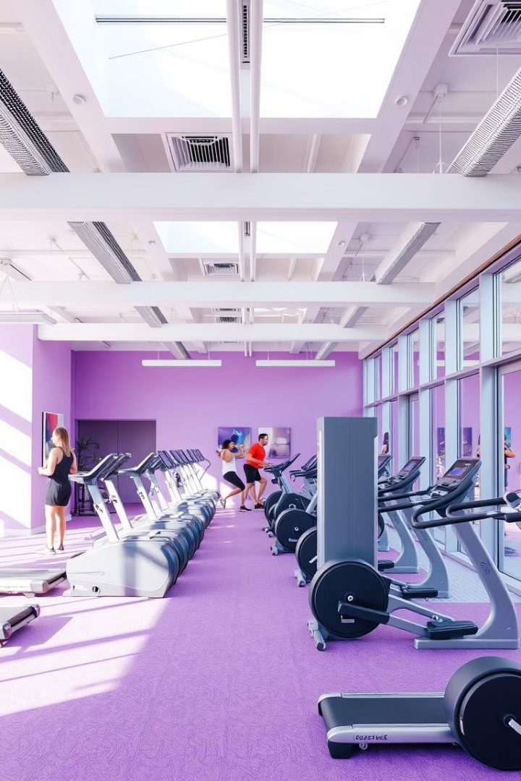
Conclusion
Automated System
Real-time Monitoring
99.9% uptime* with *cloud hosting
BI-Powered Reports
The system automates gym check-ins. It provides real-time equipment utilization monitoring. BI reports offer actionable insights. It enables a trainer dashboard with member insights. Cloud-based data management ensures security.

Slide 18

Thank You

